Slide 1
RISC-V CPU
香港人嘅CPU計劃
Ray, Peter, Derek, Darren, Yin

Slide 2
CPU Special Interest Group
Who are we

Slide 3
Appslab with Quantr Foundation
Started a project since 2019 to develop a RISC-V processor
RISC-V Assembler
RISC-V Disassembler
RISC-V Simulator
RISC-V C/C++ compiler backend
RISC-V Linker & Loader
RISC-V Processor
RISC-V Operating System

Slide 4
Our Projects

Slide 5
Our Goal
重新燃點香港人對基礎軟硬件技術的關注, 沒有基礎技術, 上層研究難以發力
Reinvigorate concerns of IT technology in HK, including both hardware and software
Lay a foundation for computer-technology research field
以城大為香港基礎軟硬件之培訓基地
Setting up a base in Cityu for cultivating IT talents
以實作為核心價值, 動手補完香港在基礎軟硬件過住沒有之嘗試
Providing students with precious hands-on experience
On a mission to accomplish unprecedented achievements in the computer industry

Slide 6
Dr Ray
Daren
Year 4
Derek
Year 4
Yin
Year 2
Peter
Lucas
Year 4

Slide 8
What is RISC-V?

Slide 9
CPU (Central Processing Unit)
Electronic circuitry that executes instructions comprising a computer program.
Function: Performs basic arithmetic, logic, controlling, and input/output (I/O) operations specified by the instructions in the program.
Common CPUs: x86, ARM, RISC-V

Slide 10
Why RISC-V ?
Involves zero new technology but has the power to gain serious international interest over the past 10+ years.
Open-source license on ISA
Software Support
- Variety of language compilers (GNU compiler collection)
- Supported by Linux Operating System
Hardware Support
- Many large companies are offering or have announced RISC-V hardware

Slide 11
Instruction Set Architecture (ISA)
ISA is an abstract model of a computer architecture, defining things such as register model, machine code instructions, as well as memory model
Specifies what the processor is capable of doing
Most ISAs are intellectual properties that is licensed $$$
Widely used ISAs: x86 and ARM architecture

Slide 12
Instruction Set Architecture (ISA)
Reduced Instruction Set Computers (RISC) and Complex Instruction Set Computers (CISC)
Common examples
CISC: Intel x86
RISC: ARM, RISC-V

Slide 13
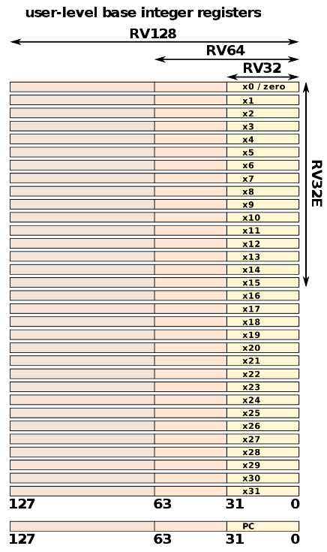
Instruction Set (RV32I)
Addition of a register and immediate
Assembly Format: addi rd, rs1, simm12
eg: addi x1, x2, 0x123
Val[x1] = Val[x2] + 0x123
Addition of registers
Assembly Format: add rd, rs1, rs2
eg: add x3, x1, x2
Val[x3] = Val[x1] + Val[x2]

Slide 14
Instruction Set (RV32I)
Most CPUs have similar instruction functions (eg: add, sub, mul, load, store)
So, what is special about RISC-V instruction set?

Slide 15
Opcodes (Operation Code)
CPUs don't understand assembly instructions, they understand Opcodes
Opcodes are also known as Instruction Machine Code
Most instructions are 32-bits
eg: addi x1, x2, 0x123 (I-type)
Machine Code: 0001 0010 0011 00010 000 00001 0010011 (binary) or 1231 0093 (hex)

Slide 16
Opcodes (Operation Code)
Programmers won't write opcodes/machine codes themselves (impossible)
CPU can only understand opcodes/machine codes
So, How are assembly programs changed to machine codes?
Assembler
Disassembler

Slide 17
Assembler
A computer program which translates assembly language to machine language, which consists of several smaller components like:
Parser
Lexer
Encoder

Slide 18
Disassembler
A computer program that translates machine language into assembly
Often formatted for human-readability rather than suitability for input to an assembler, making it principally a reverse-engineering tool
Input
Output

Slide 19
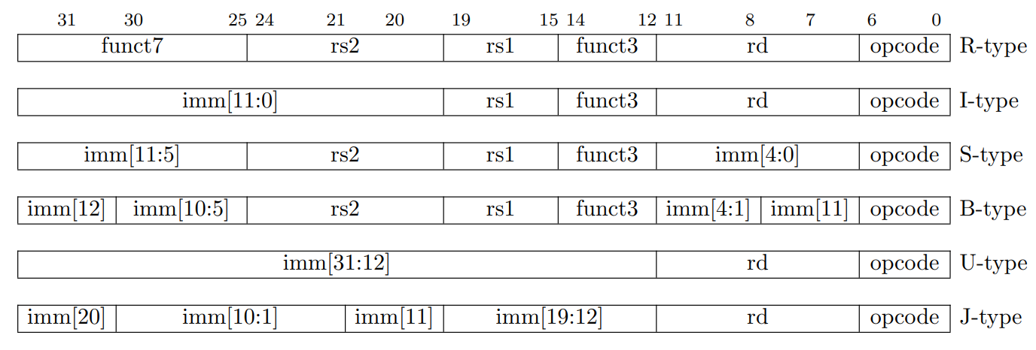
RISC-V Base Type Instructions
Yin
RISC-V base instruction formats
opcode - determine instruction
rd - destination register
rs1/rs2 - source registers
funct3 - determine instruction (advanced)
funct7 - determine instruction (more advanced)
imm - immediate value/offset = constant integer data
RISC-V base instruction formats showing immediate variants

Slide 20
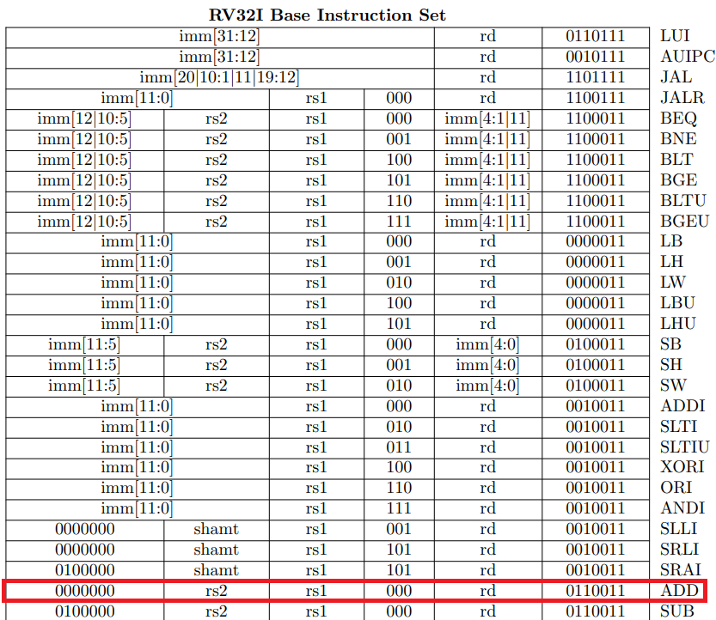
RISC-V Instruction Assemble
Yin
example code: add x0, x1, x2
Syntax of instruction (add) - add rd, rs1, rs2
Opcode - 0110011
rd - x0 (00000)
funct3 - 000
rs1 - x1 (00001)
rs2 - x2 (00010)
funct7 - 0000000
add | rd | rs1 | rs2
add | x0 | x1 | x2

Slide 21
RISC-V Instruction Assemble
Yin
example code: add x0, x1, x2
000000 | 00010 | 00001 | 000 | 00000 | 0110011 | ADD
Syntax of instruction (add) - add rd, rs1, rs2
Opcode - 0110011
rd - x0 (00000)
funct3 - 000
rs1 - x1 (00001)
rs2 - x2 (00010)
funct7 - 0000000
concatenate all bits:
0000000001000001000000000110011
Convert the binary representation into hexadecimal representation:
00208033

Slide 22
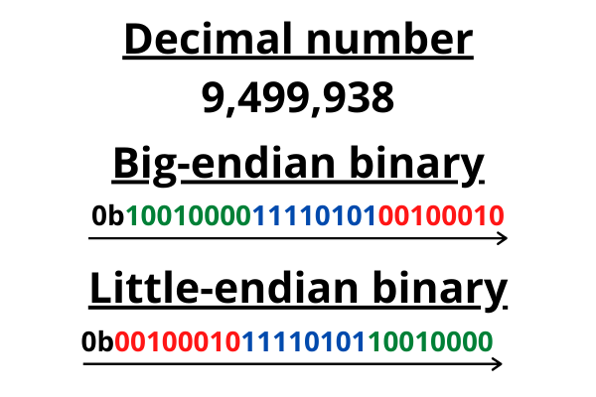
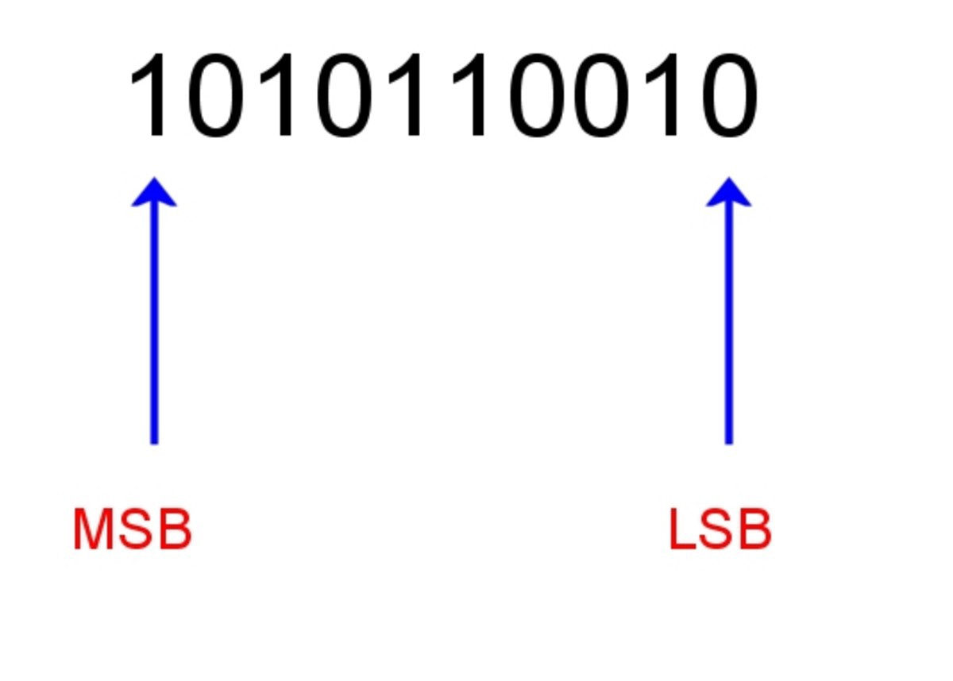
Endianness
Yin
Different languages read their text in different orders. English reads from left to right, while Arabic is read from right to left.
This is exactly what endianness is for computers. It means that the bytes in computer memory are read in a certain order.
Big-endian - The most significant byte (MSB) of the data is placed at the byte with the lowest address.
Small-endian - the opposite of dig-endian.

Slide 23
RISC-V Instruction Assemble
Yin
Standard RISC-V is entirely little-endian.
-> The least significant byte (LSB) of the data is placed at the byte with the lowest address.
Our hexadecimal representation is 00208033.
Therefore the stored data will be 33802000.
BOOM!
We have successfully assembled a RISC-V instruction!

Slide 24
RISC-V Instruction Disassemble
Yin
After assembling the file, the content of the output file will be a hex dump.
Hex dump: A hexadecimal view of computer data, from memory or from a computer file or storage device.
Using the previous result, the content of the output file is now 33802000.
We convert it into little-endian binary expression:
0000000001000001000000000110011
7 least significant bit expression (opcode): 0110011
It is one of the opcode of Type R instructions.
Syntax of a Type R instruction:
\
We then compare the bytes of funct3 and funct7:
funct3: 000
funct7: 000000

Slide 25
RISC-V Instruction Disassemble
Yin
We now have the follow information:
Opcode: 0110011
funct3: 000
funct7: 000000
By looking up at the instruction table again,
we know that the instruction is ADD.

Slide 26
RISC-V Instruction Disassemble
Yin
zero: alternative representation of x0 register
ra: alternative representation of x1 register
sp: alternative representation of x2 register
By comparing the other bytes (rd, rs1, rs2)
We can find the registers in the instruction:
rd (00000) = x0
rs1 (00001) = x1
rs2 (00010) = x2
BOOM!
We have successfully disassembled a RISC-V instruction!

Slide 27
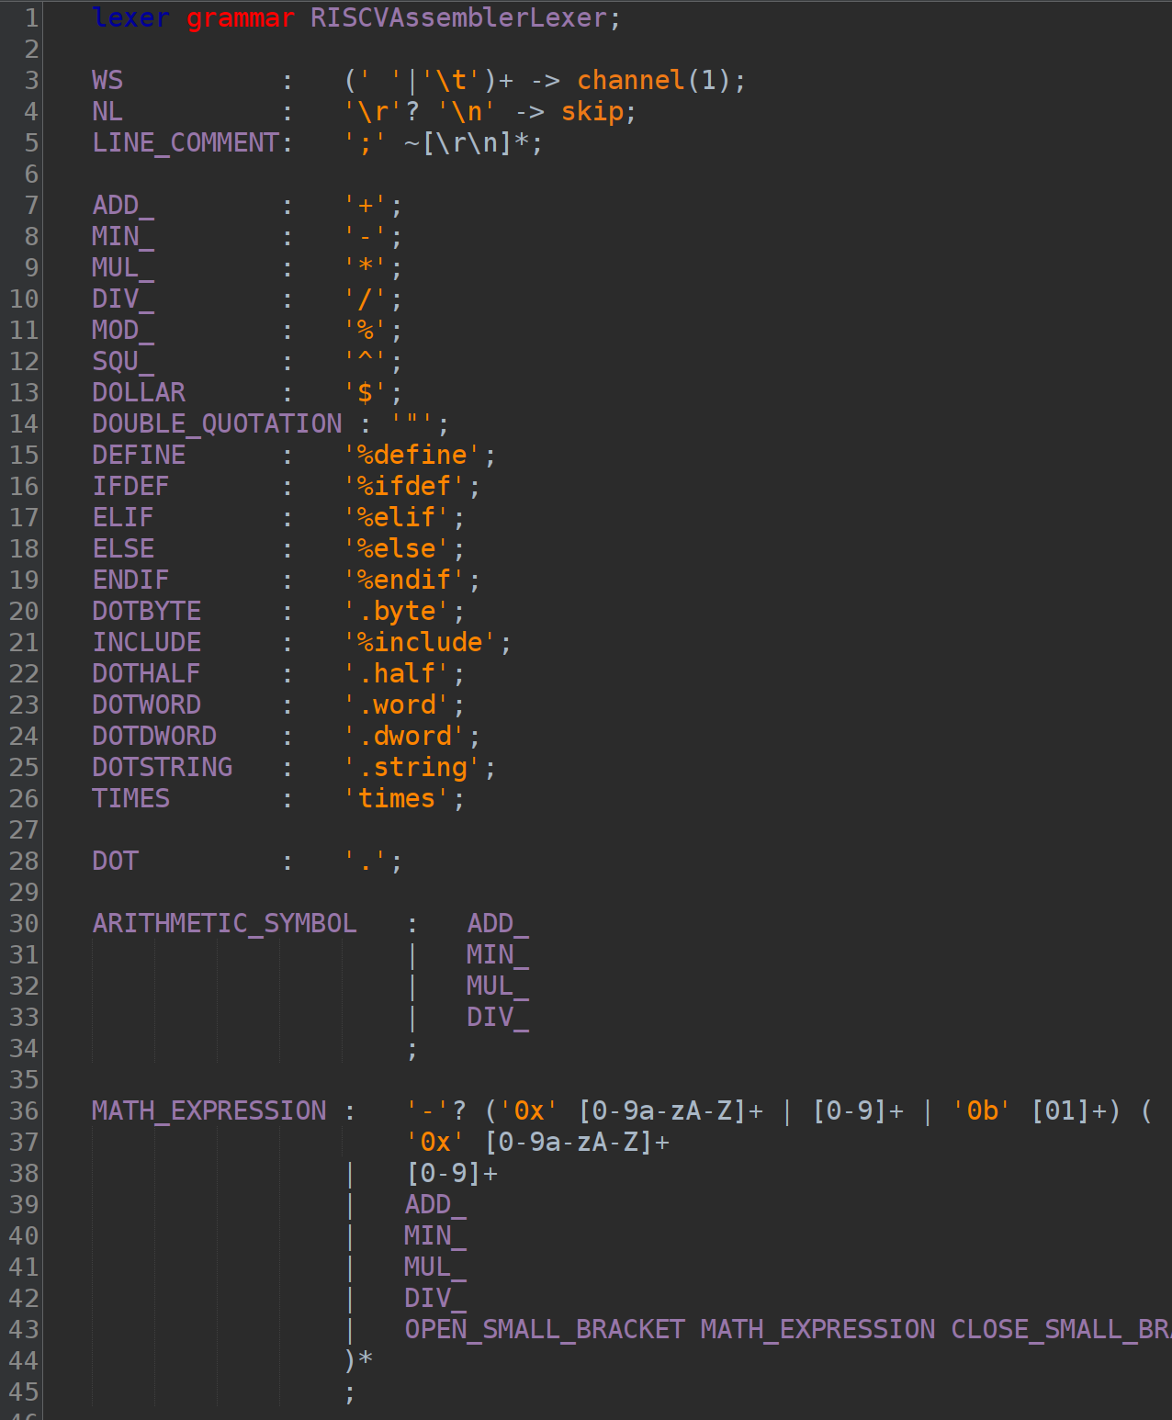
Basic principle of our assembler (lexer)
Yin
ANTLR: A very powerful tool for processing structured text.
Use ANTLR to create one Lexer file and one Parser file.
Lexer file: Break down a sentence into fragments.
We will break down all contents of the file into tokens.
Such as, the expression “^.^” will be break down into SQU_ DOT SQU_.

Slide 28
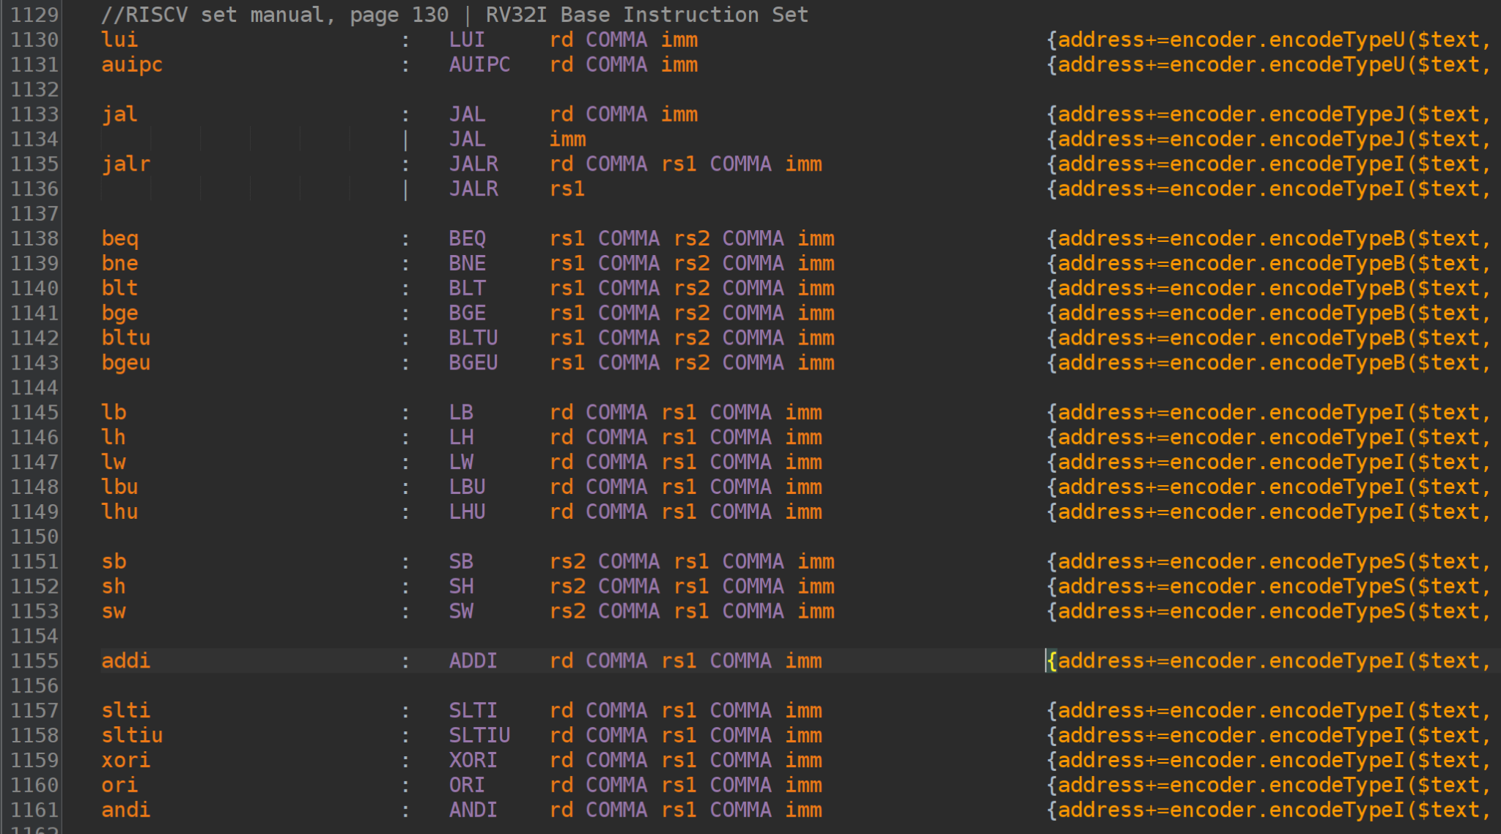
Basic principle of our assembler (parser)
Yin
The tokens will then be parsed by the parser.
Parser file: Parse token stream and do further actions.
such as: “addi x0,x1,123”
will be broken down by the lexer into
“ADDI rd COMMA rs1 COMMA imm”
If the corresponding syntax is found, the context inside the brackets in the back of the rule will be executed.
Else, if the rule is not found, an error will pop up.

Slide 29
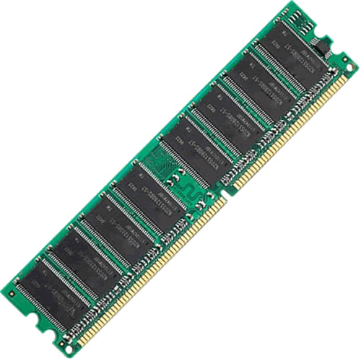
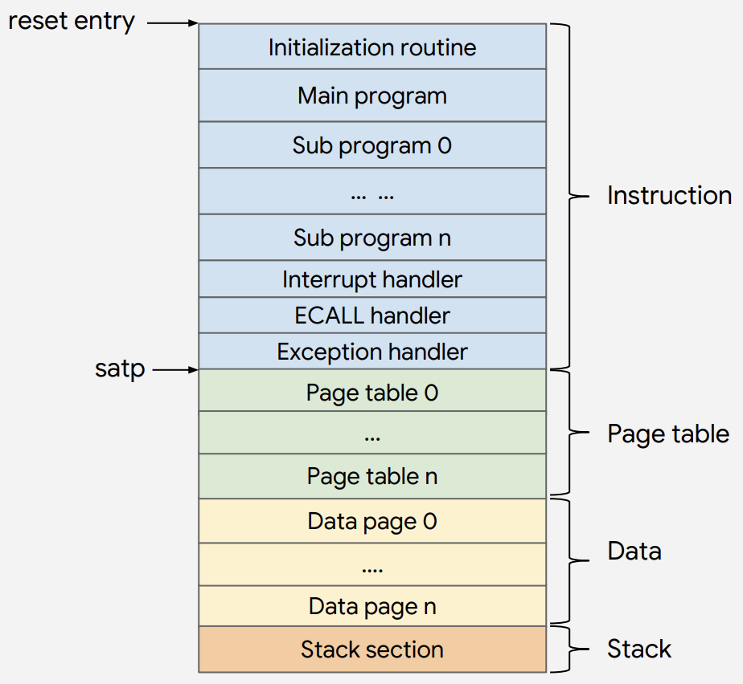
Memory
Used to store working data and machine code
Memory Mapping allows data to be organized in different sections!
Memory size = Very Large!!!

Slide 30
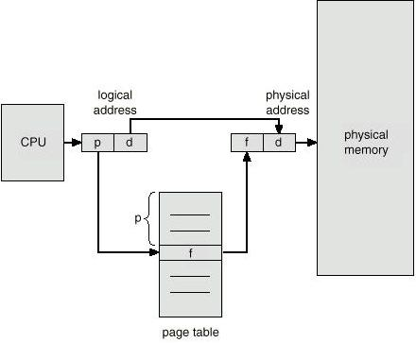
Paging
Common Paging modes: sv32, sv39, sv48
Paging is a computer memory management function that presents storage locations to the CPU as additional memory
Providing a virtual address, the computer finds the physical address for you Results in: better and faster memory allocation!
VA 0 -> PA 0x00000000
VA 1 -> PA 0xffffffff

Slide 31
Paging
Sv39 and Sv48 are page-based virtual-memory architectures for RV64 systems providing a 39-bit or 48-bit virtual address space respectively to support modern supervisor-level operating systems, including Unix-based systems.
Sv32, Sv39, and Sv48 require implementations to support M, S, and U privilege levels. If H-mode is also present, additional operations are defined for hypervisor-level code to support multiple supervisor-level virtual machines. Hypervisor-mode support for virtual machines has not yet been defined.

Slide 32
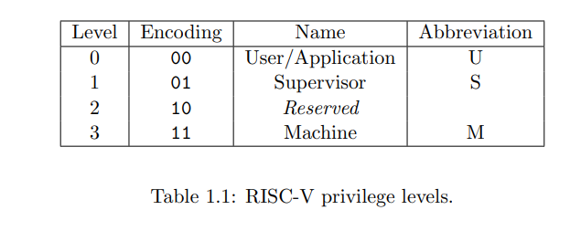
RISC-V Privilege Modes
Machine mode (M-mode)
Supervisor mode (S-mode)
User Mode (U-mode)

Slide 33
RISC-V Privilege Modes
Supported combination of mode:
-M (single embedded systems)
-M,U (embedded systems with security)
-M,S,U ((systems running Unix-like operating systems)

Slide 34
Control and Status Registers (CSRs)
used for all privileged instruction - defined as Zicsr extension
CSRs and instructions are associated with one privilege level but they are also accessible at all higher privilege levels

Slide 35
Machine mode (M-mode)
highest privilege mode in a RISC-V system
used for low-level access to a hardware platform and is the first mode entered at reset

Slide 36
How to implement the above concept?
run simulator sv39 a.s

Slide 37
UART
stands for“Universal Asynchronous Receiver-Transmitter”
physical hardware device used to transmit and receive serial data.
Serial data transmission is the process of sending data sequentially, bit-by-bit.

Slide 38
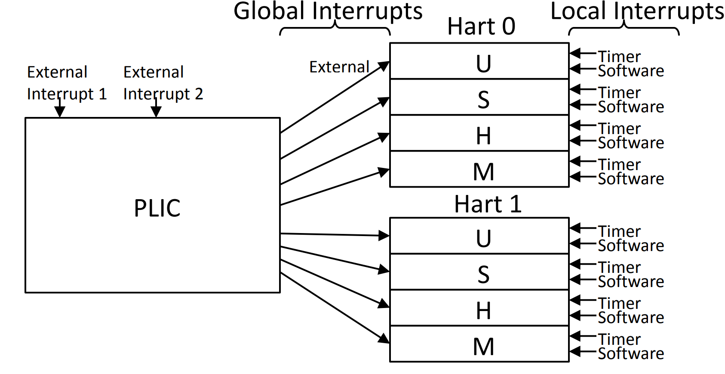
Interrupt

Slide 39
Interrupt
Local Interrupts (software interrupt and timer interrupt)
-Directly connected to one hart(hardware thread)
-Determine source directly through CSR
-Only two standard local interrupts
-timer interrupt occurs when mtime>mtimecmp
Global Interrupts(external)
-Routed via Platform-Level Interrupt Controller (PLIC)(the Programmable Interrupt Controller for riscv)
-PLIC arbitrates between multiple harts claiming interrupt
-Read of memory-mapped register returns source

Slide 40
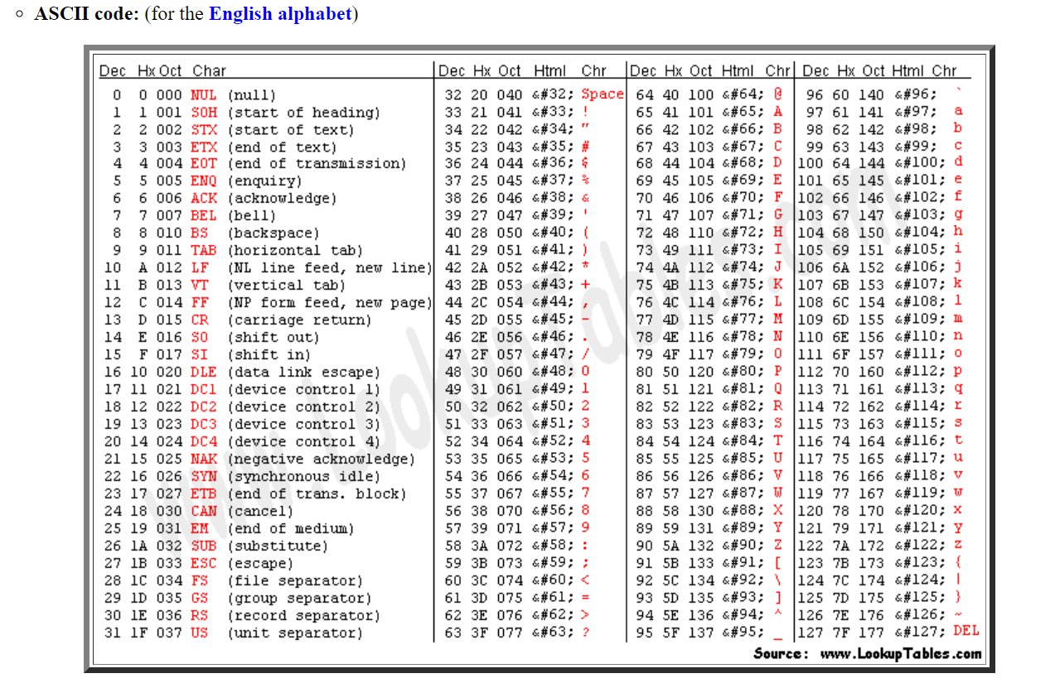
Interrupt
run example(multitasking)
run example(virtio)(uart_read)

Slide 41
RISC-V Processor
Written in Verilog
Progress:
Working 5-Staged Pipeline that can manage most instructions in RV32I and RV64I instruction set

Slide 42
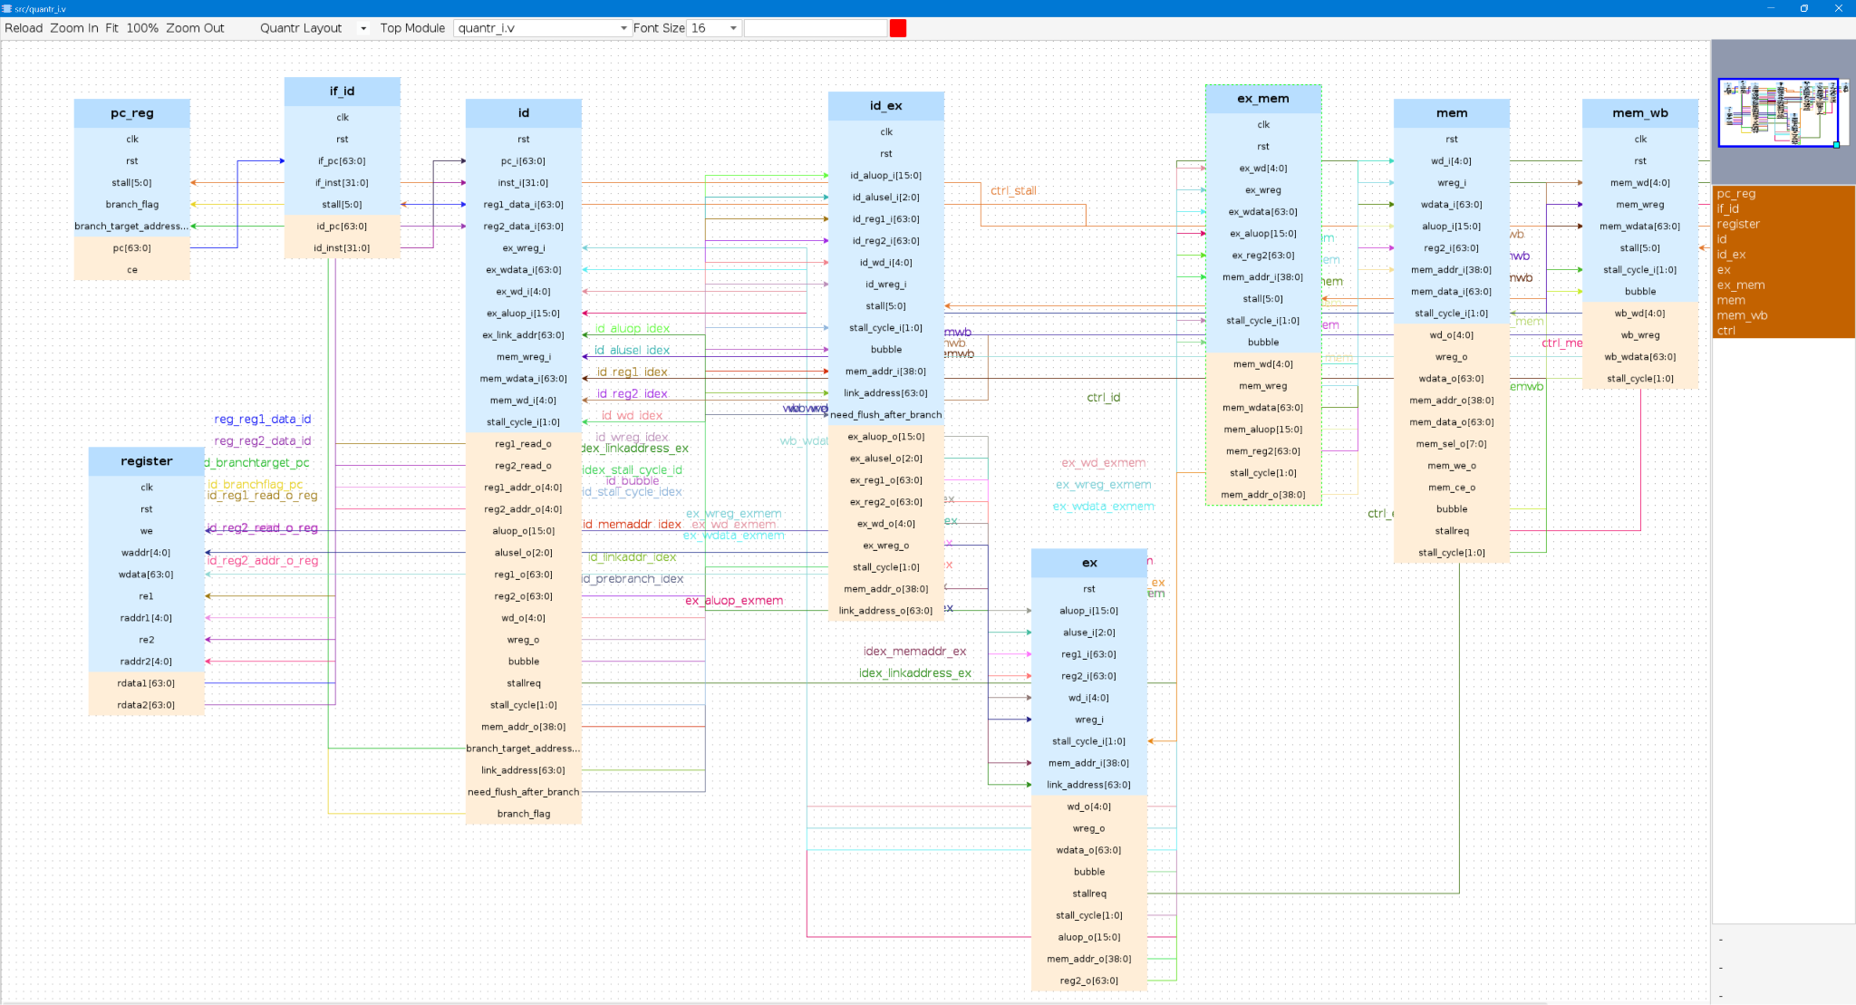

Slide 43
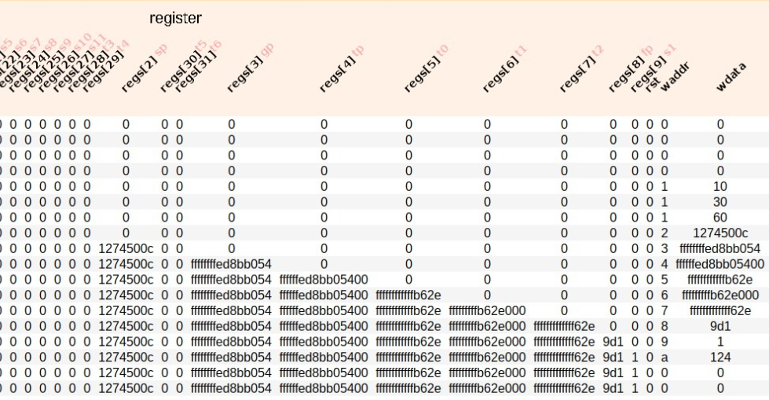
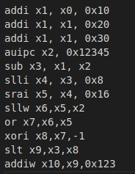
clk

Slide 44
Join us
If you are interested in this project as well
Contact us:
racheung@cityu.edu.hk
peter@quantr.hk
The End ~

